Slide 1
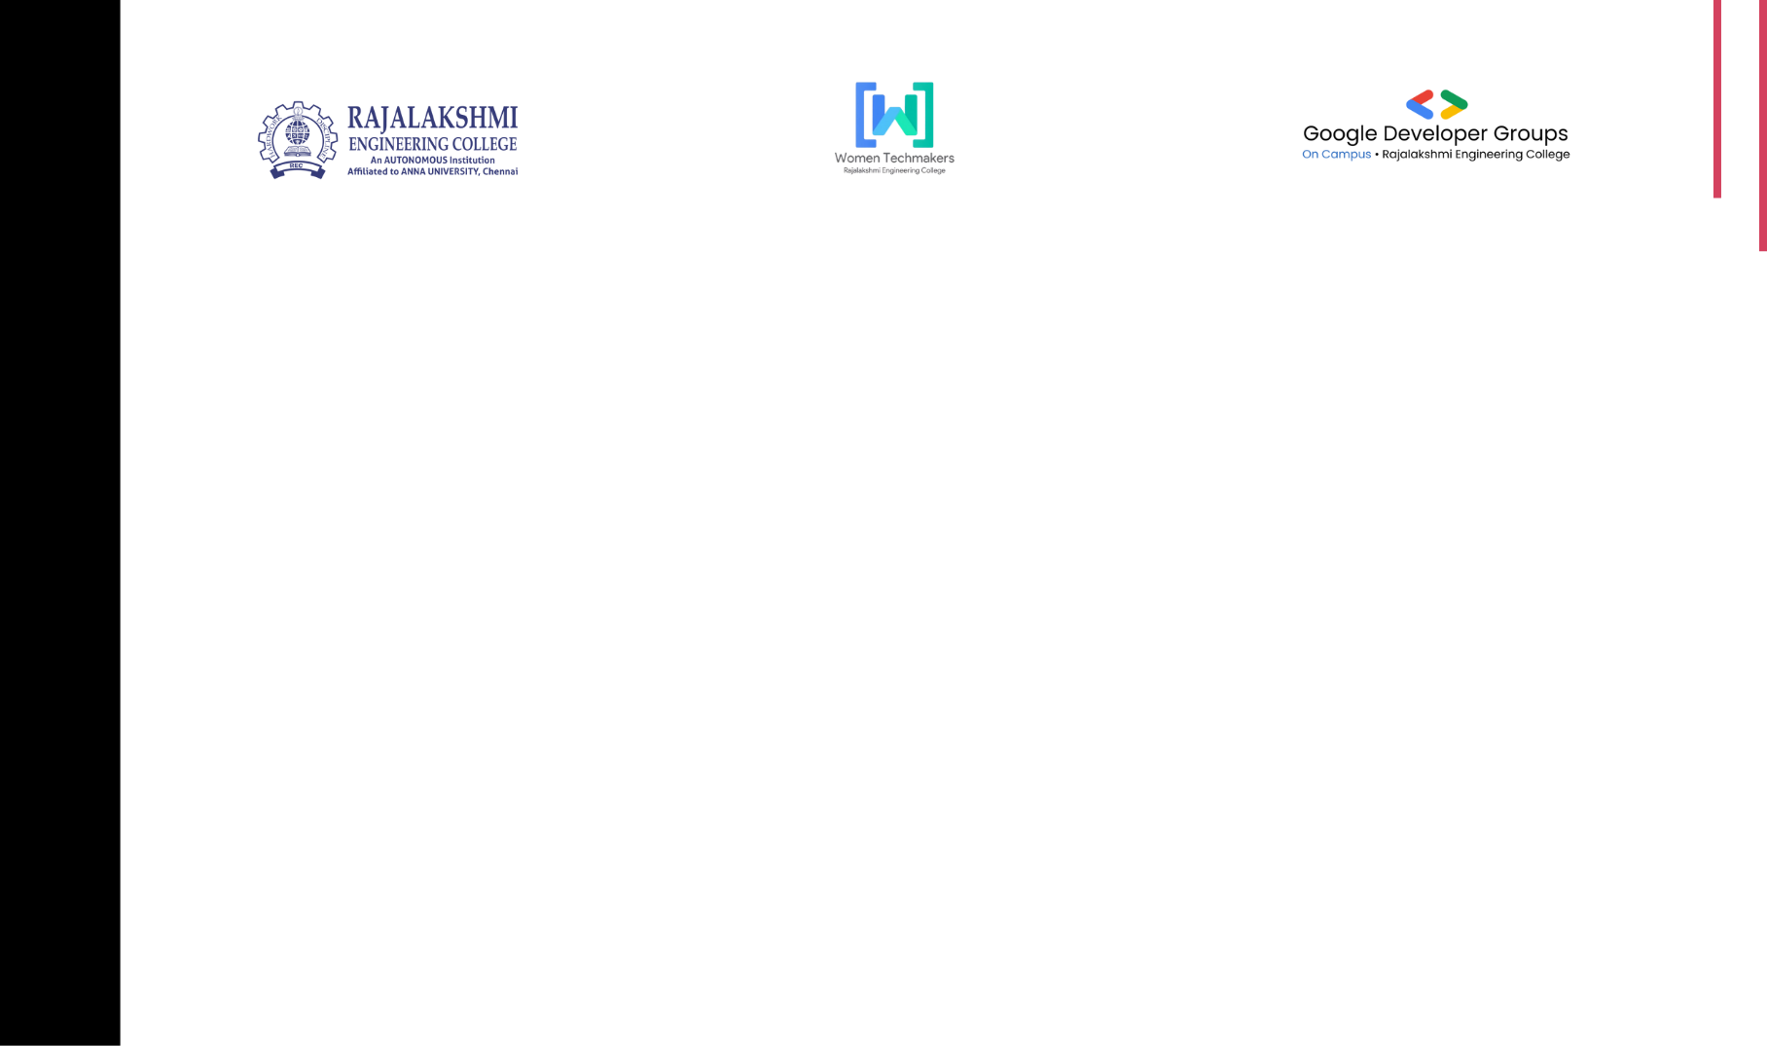

Electro Spark
TITLE PAGE
Early Parkinson’s Disease Detection Using Voice and Spiral Drawing Through AI Integration
Problem Statement Title-
Theme- Health & Well-being
Team Name- Electro Spark

Slide 2

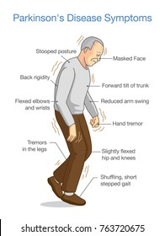






Electro Spark
PROBLEM STATEMENT
Early symptoms of Parkinson’s disease, such as hand tremors and speech changes, often go unnoticed and undiagnosed. This project aims to develop a mobile application that uses AI-based analysis of handwritten spiral drawings and voice recordings to help in the early detection of Parkinson’s disease in an accurate, accessible, and non-invasive way.
😣 User Pain Points
Patients feel symptoms but get no clear answer.
Long wait times for diagnosis.
Expensive or inaccessible tests.
Anxiety due to uncertainty.
🧪 Existing Systems
MRI and clinical evaluations (costly & limited).
Some mobile apps (not accurate or user-friendly).
Lack of combined voice + drawing-based systems.
2

Slide 3

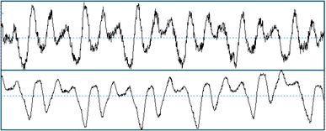
Electro Spark
IDEA TITLE
Proposed Solution
Handwritten spiral to deploy in ML
💡 Abstract
Parkinson’s disease is hard to detect early.
Our project aims to catch early symptoms using a simple mobile/web-based tool.
It analyzes voice patterns and hand-drawn spirals to find signs.
The goal is early, affordable, and non-invasive diagnosis.
🛠️ Explanation of the Proposed Solution
User records voice (e.g., saying "ahhh") and draws a spiral on the screen.
Features are extracted from voice (frequency, jitter) and drawing (shakiness).
A trained machine learning model predicts the likelihood of Parkinson’s.
Results are shown instantly or sent to a doctor securely.
🌟 Novelty / Uniqueness
Combines two input types (voice + handwriting).
Uses AI models for better accuracy.
Can work remotely, even without hospitals.
Can be deployed on mobile apps or web apps.
Voice signal of a patient with Parkinson's disease

Slide 4
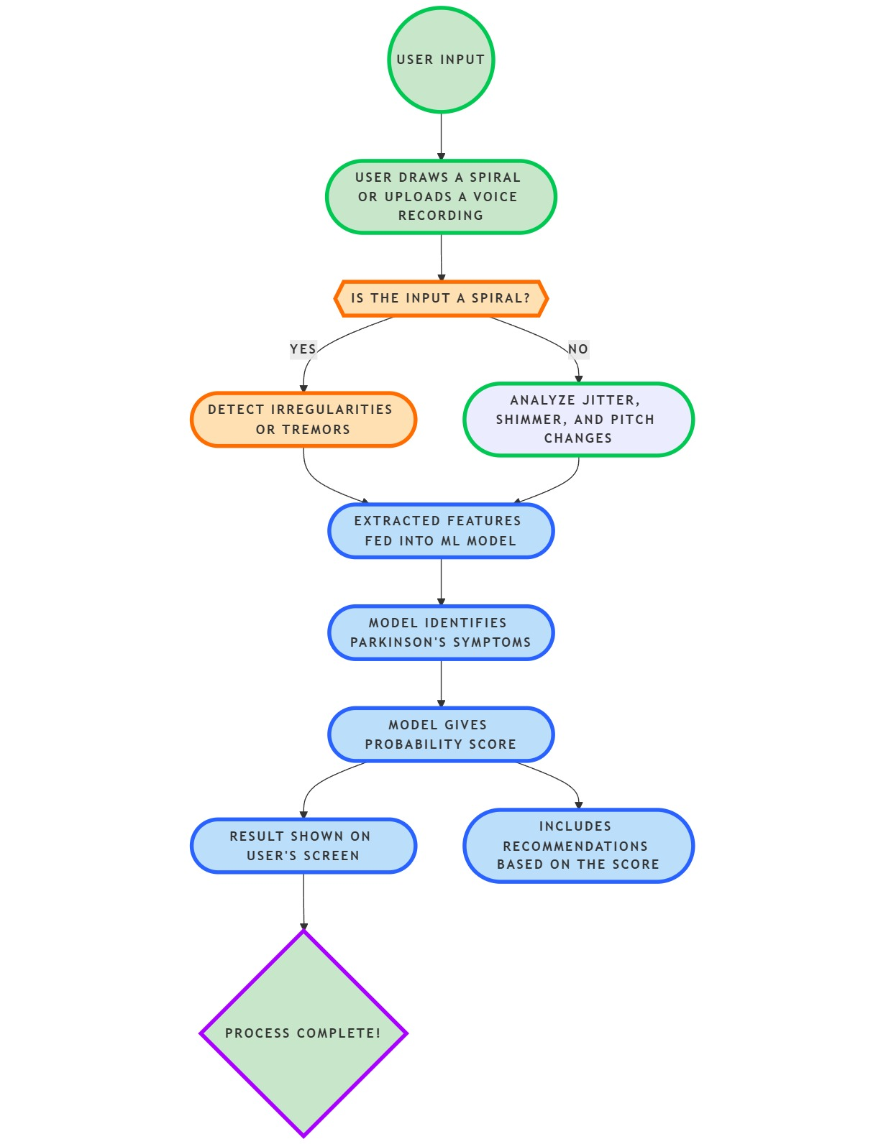





Electro Spark
TECHNICAL APPROACH
Technology Stack
Frontend streamlit
Backend
Python
Data base
Mysql
Python libraries
Torch, torch audio, numpy
transformer
numpy
pandas
scikit-learn
librosa
opencv-python
matplotlib

Slide 5
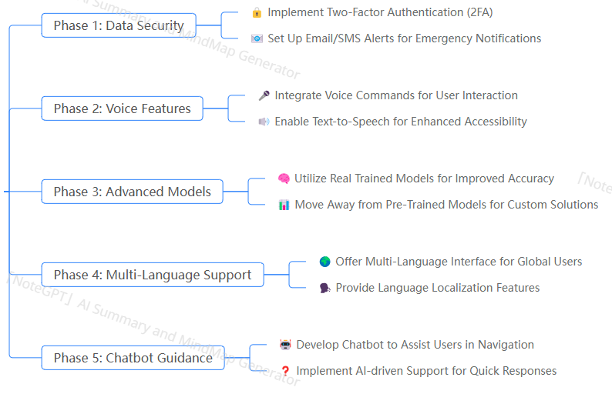
FUTURE SCOPES

Slide 6
Electro Spark
FEASIBILITY AND VIABILITY
🔧 Technically Feasible: Uses lightweight models and mobile-compatible tools
💰 Low Cost: No expensive sensors or devices needed
📱 User Friendly: Can be used by older adults too
🧪 Reliable: Uses proven datasets and research-backed methods
📈 Scalable: Can add more features like emotion tracking, feedback, etc.

Slide 7
Electro Spark
IMPACTS AND BENEFITS
💡 Early detection = early treatment
❤️ Saves lives and reduces suffering
🧠 Encourages awareness about Parkinson’s
🏥 Helps doctors make faster decisions
📲 Easy-to-use app helps remote areas too
🌟 Can expand to detect other brain disorders later

Slide 8
Electro Spark
RESEARCH AND REFERENCES
Parkinson’s Voice Dataset – UCI Machine Learning Repository
Spiral Drawing Analysis – IEEE Xplore & ResearchGate papers
Voice Frequency AI – Librosa library
Machine Learning Model – Scikit-learn
AI Model Hosting – Firebase / Flask API (basic server setup)

Slide 9
Electro Spark
TEAM MEMBERS DETAILS
Team Leader - Name / Dept / Year :
Nilopher Taj B / ECE / 2nd year
Team Member 1 - Name / Dept / Year :
Krithi D / ECE/2nd yr
Team Member 2 - Name / Dept / Year :
Rishika Venkatesh / ECE / 2nd year
Team Member 3 - Name / Dept / Year :
M R Nandhini / ECE / 2nd year

